Slide 1
Mixed ANOVA (GLM 5)
Prof. Andy Field

Slide 2
Aims
What is mixed ANOVA?
Carrying out mixed ANOVA using R
Interpretation
Main effects
Interactions

Slide 3
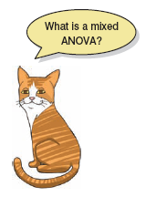
What Is Three-Way Mixed ANOVA?
Three independent variables
Three-way = 3 IVs
Mixed:
1 or more independent variables use the same participants
1 or more independent variables use different participants
A.k.a. ‘mixed-plot design’

Slide 4
An Example: Speed Dating
Is personality or looks more important?
IV 1 (Looks): Attractive, Average, Ugly
IV 2 (Personality): High Charisma, Some Charisma, Dullard
IV 3 (Gender): Male or Female?
Dependent variable (DV): P’s rating of the date
100% = The prospective date was perfect!
0% = I’d rather date my own mother

Slide 5
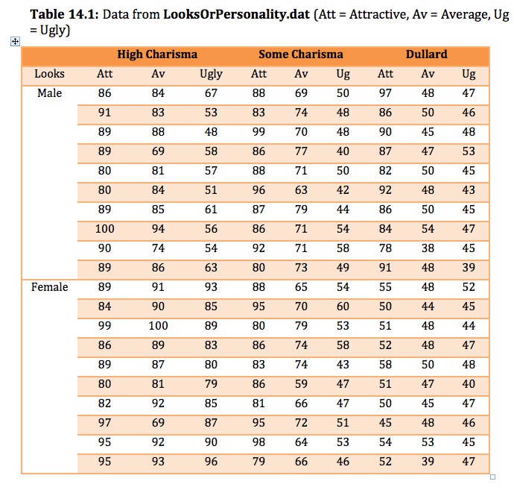

Slide 6
Effects
Main effects
We will get an F-ratio for the main effect of each independent variable:
Looks
Personality
Gender
Two-way interactions
We will get F-ratios for all possible interactions between pairs of variables:
Looks × Personality
Looks × Gender
Personality × Gender
Three-way interactions
We will get an F-ratio for the interaction between all three variables
Looks × Personality × Gender

Slide 7
Entering the Data
We need the data to be in the long format. We can again use the melt() function :
speedData<-melt(dateData, id = c("participant","gender"), measured = c("att_high", "av_high", "ug_high", "att_some", "av_some", "ug_some", "att_none", "av_none", "ug_none"))
The latter two labels are not helpful so we’ll rename these columns so that we know what they represent:
names(speedData)<-c("participant", "gender", "groups", "dateRating")

Slide 8
Entering the Data
The variable groups is a mixture of our two predictor variables (looks and personality). We need to create two variables that dissociate them.
Create a variable called personality:
speedData$personality<-gl(3, 60, labels = c("Charismatic", "Average", "Dullard"))
Create a variable called looks:
speedData$looks<-gl(3, 20, 180, labels = c("Attractive", "Average", "Ugly"))

Slide 9
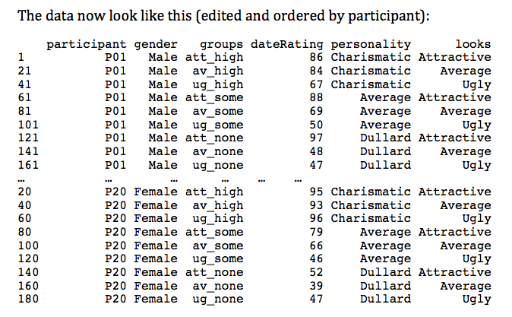
Entering the Data

Slide 10
Contrasts

Slide 11
Mixed ANOVA
We can use the ezANOVA() function in much the same way as for a repeated measures design. The only difference is that we can add our between-group variable (gender) by using the between = .() option:
speedModel<-ezANOVA(data = speedData, dv = .(dateRating), wid = .(participant), between = .(gender), within = .(looks, personality), type = 3, detailed = TRUE)
speedModel

Slide 12
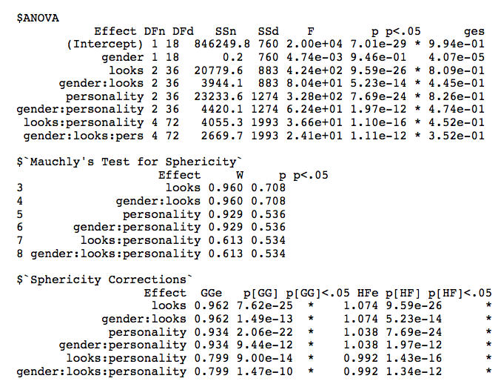
Output

Slide 13
Mixed designs as a GLM

Slide 14
Building the Model
baseline<-lme(dateRating ~ 1, random = ~1|participant/looks/personality, data = speedData, method = "ML")
Add main effects one at a time:
looksM<-update(baseline, .~. + looks)
personalityM<-update(looksM, .~. + personality)
genderM<-update(personalityM, .~. + gender)

Slide 15
Building the Model
Add two-way interactions one at a time:
looks_gender<-update(genderM, .~. + looks:gender)
personality_gender<-update(looks_gender, .~. + personality:gender)
looks_personality<-update(personality_gender, .~. + looks:personality)

Slide 16
Building the model
Add the three-way interaction to the model:
speedDateModel<-update(looks_personality, .~. + looks:personality:gender)
To compare these models we can list them in the order in which we want them compared in the anova() function:
anova(baseline, looksM, personalityM, genderM, looks_gender, personality_gender, looks_personality, speedDateModel)

Slide 17
Output

Slide 18
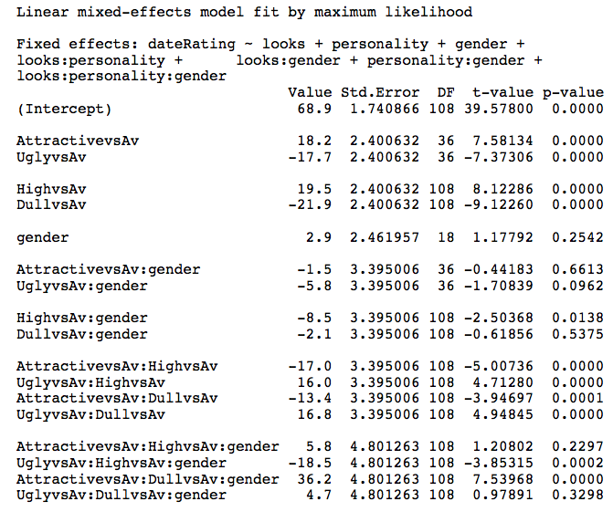
Model Parameters

Slide 19
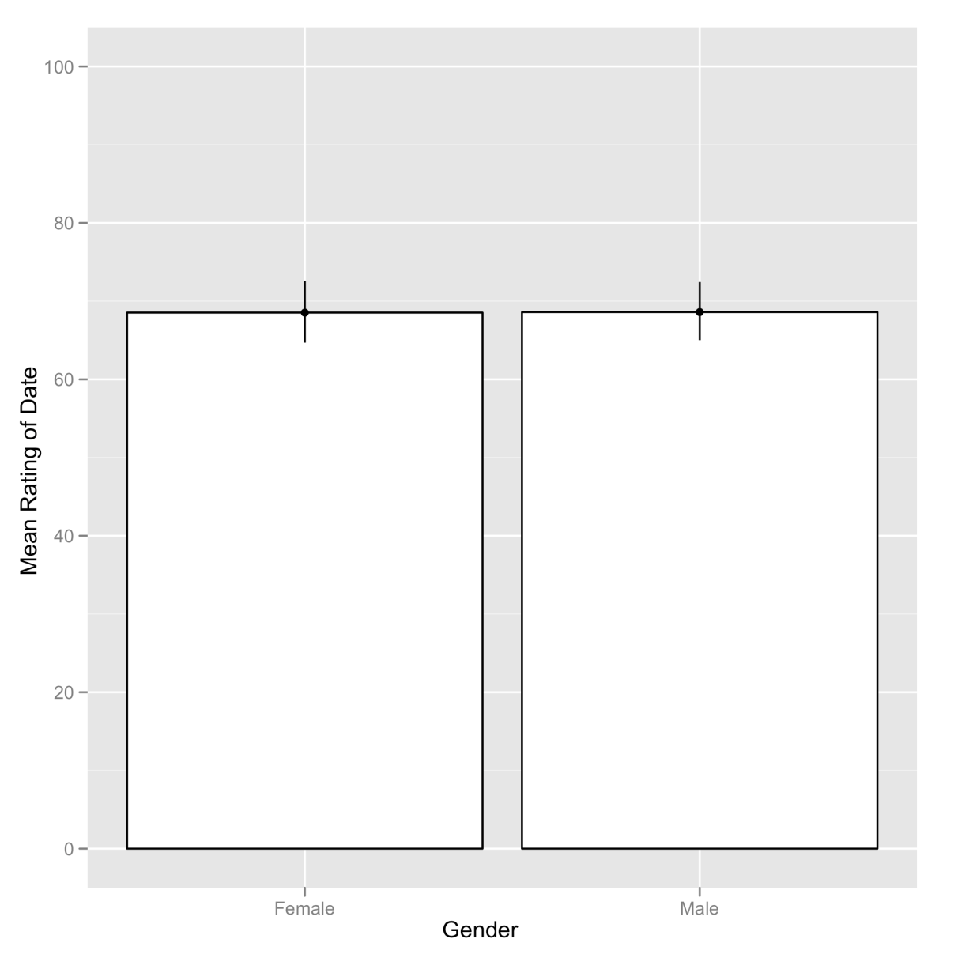
Main Effect of Gender

Slide 20
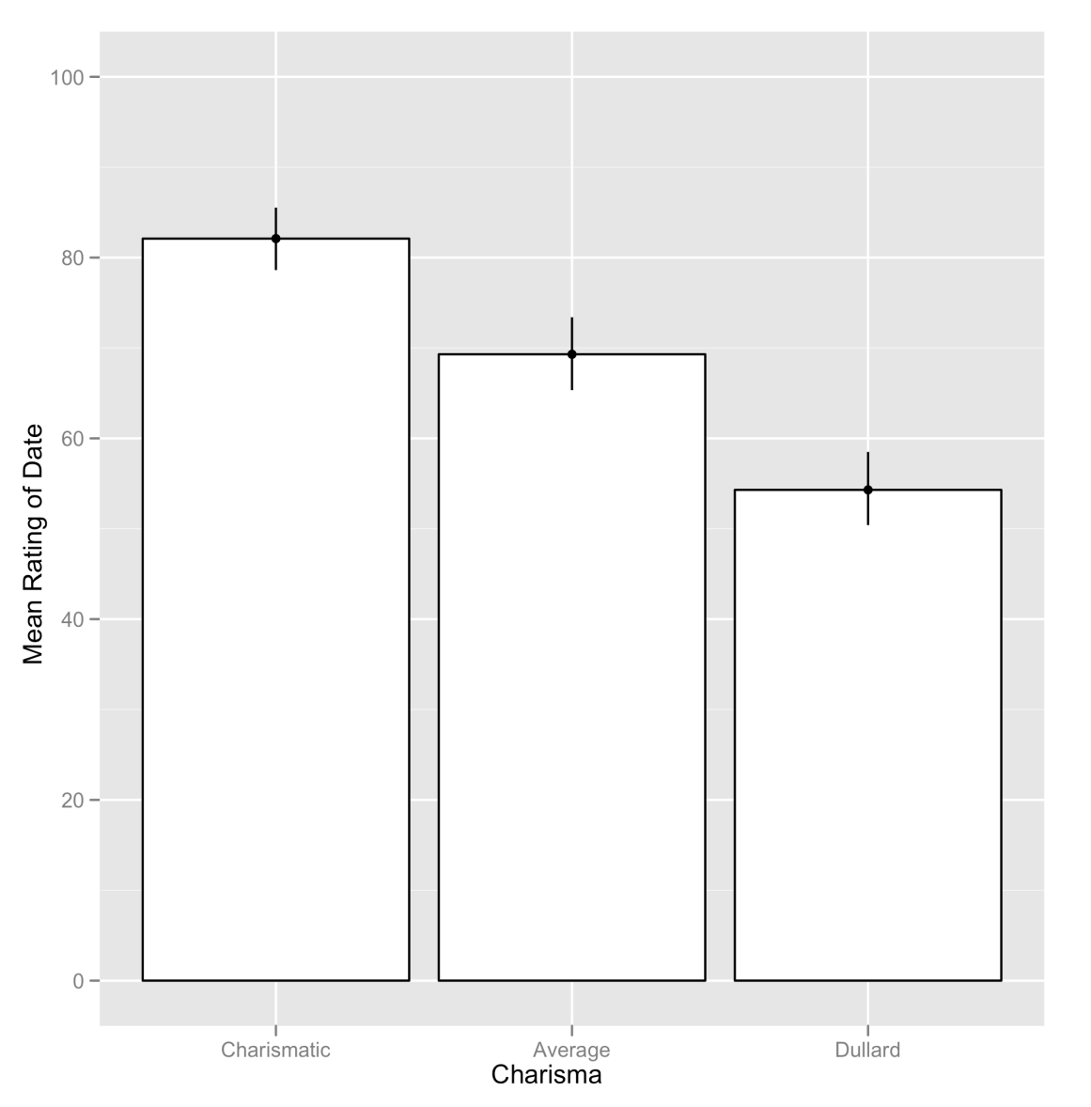
Main Effect of Looks

Slide 21
Main Effect of Charisma

Slide 22
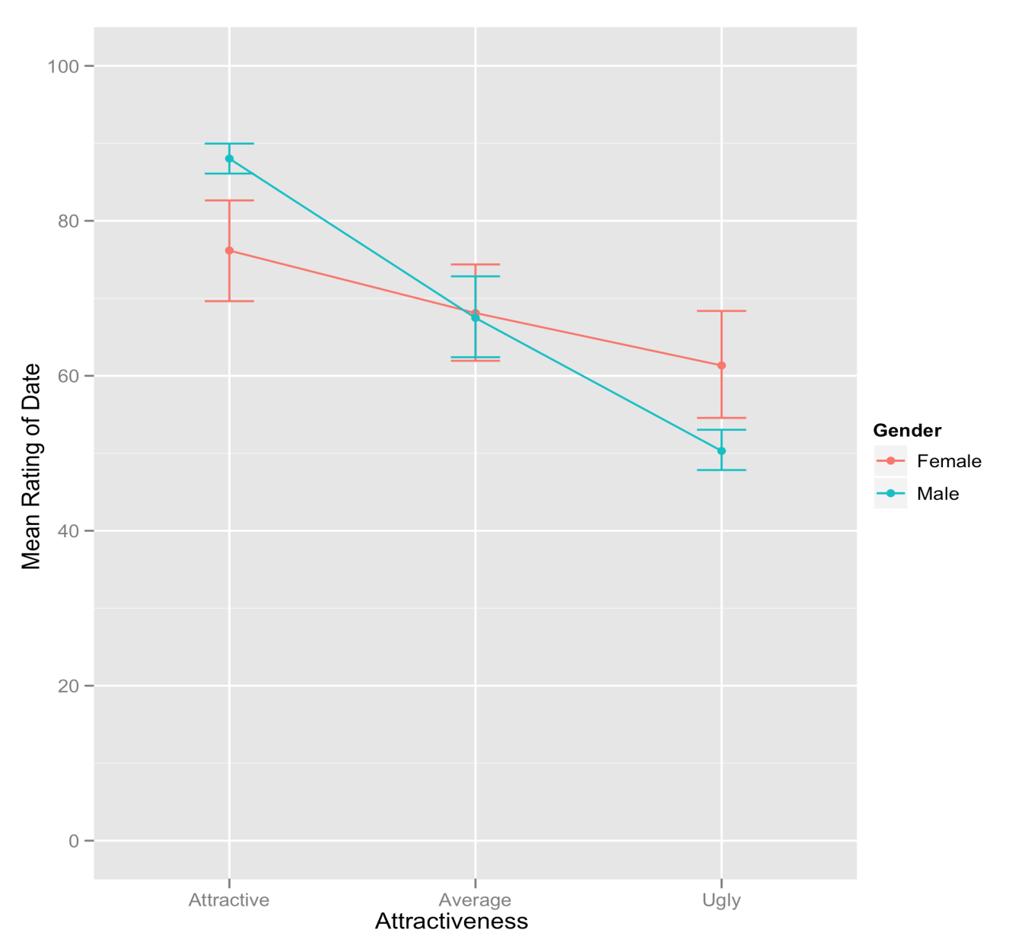
The Gender × Looks Interaction

Slide 23
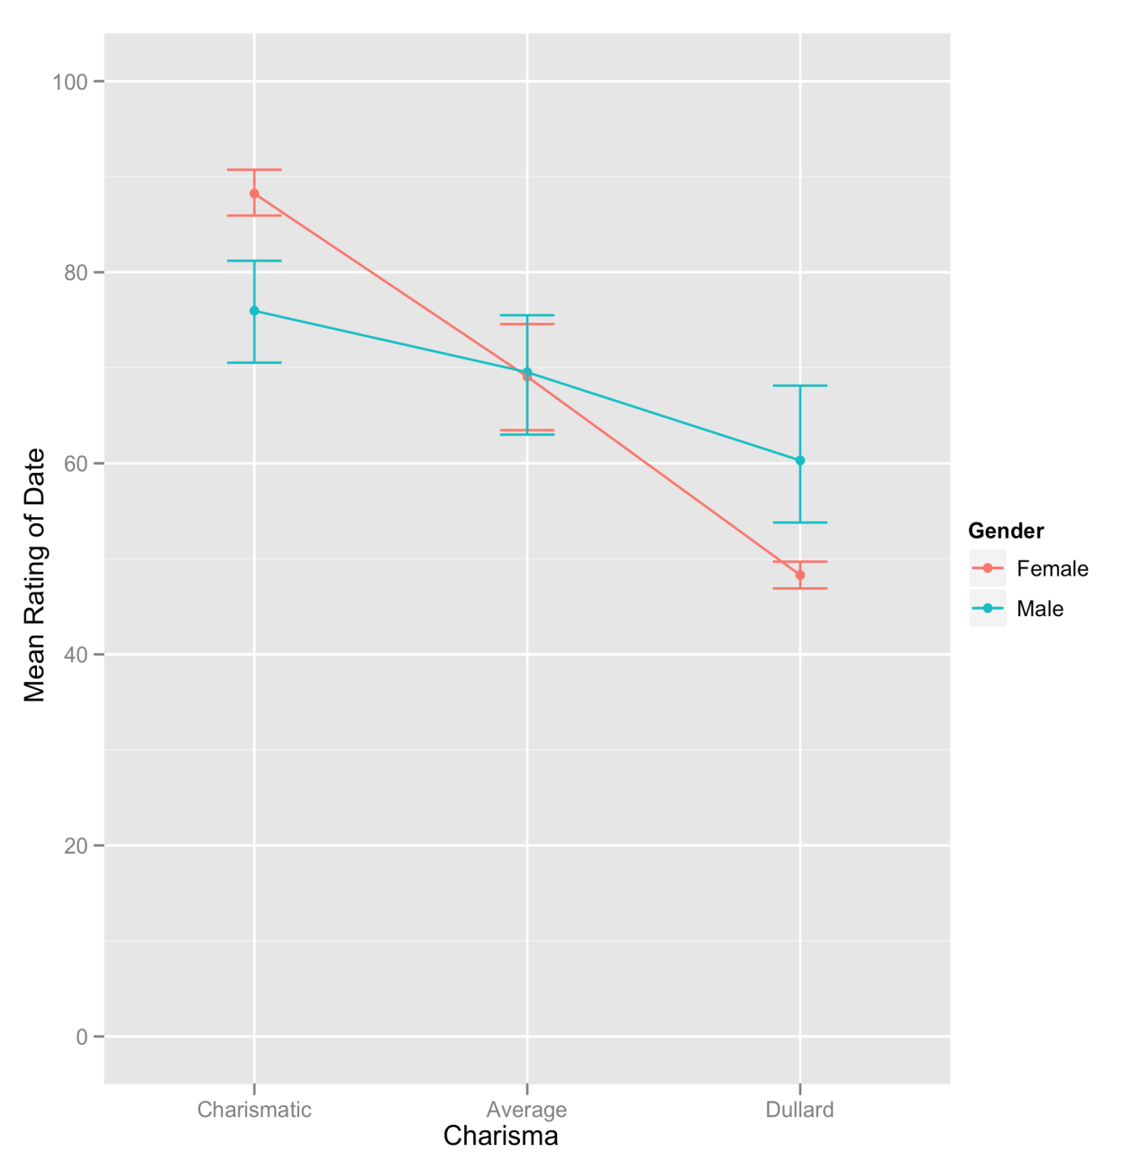
Gender × Charisma Interaction

Slide 24
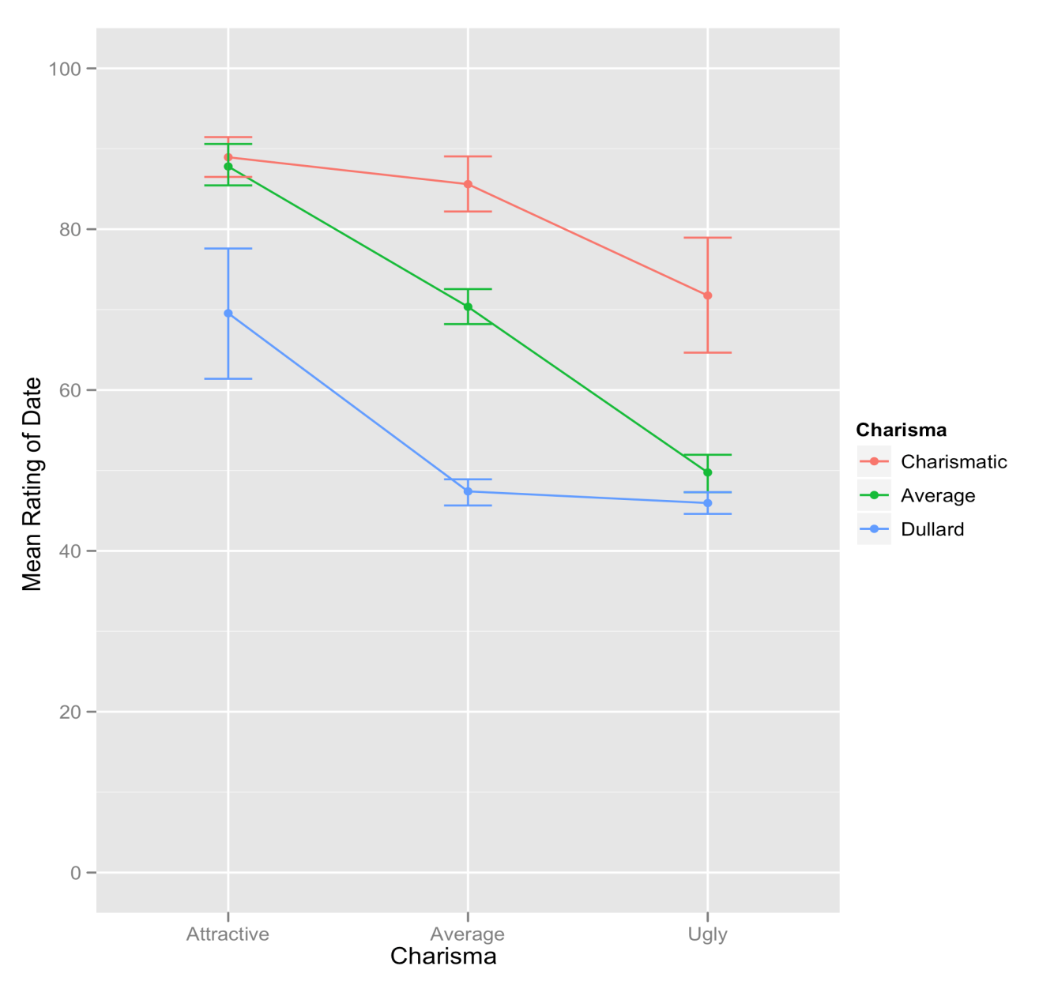
The Looks × Charisma Interaction

Slide 25
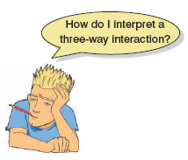

Slide 26
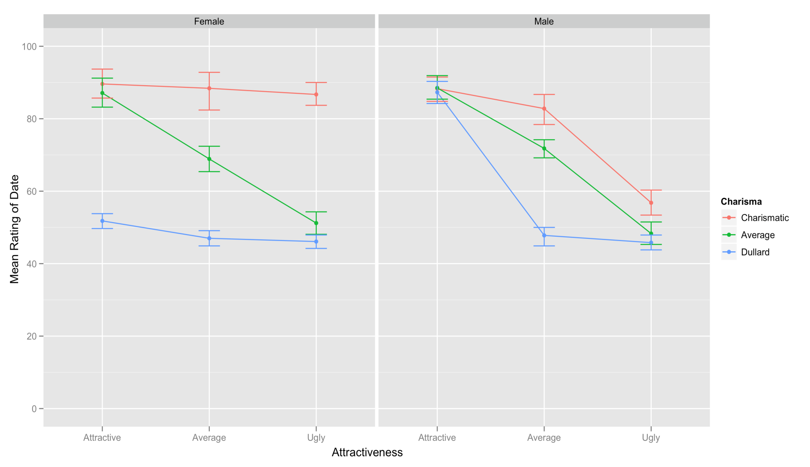
Gender × Looks × Charisma Interaction

